Slide 1
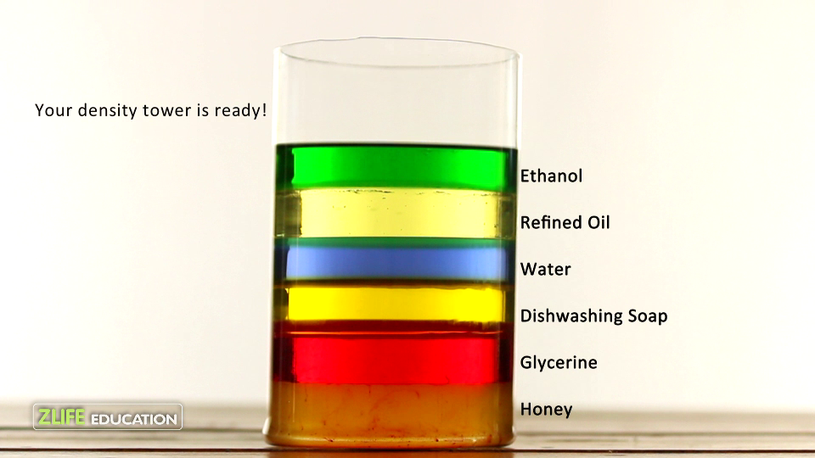
Density
Measuring Liquids

Slide 2
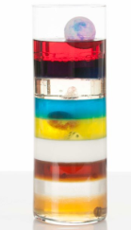
Liquids Have Density
http://www.youtube.com/watch?v=-CDkJuo_LYs
Liquids with different densities form __________
  The liquid with the _________ density
  will be on the ____________.
  The liquid with the _________ density
  will be on the _______.
Solid objects can _____ or ____
in liquids with different densities

Slide 3
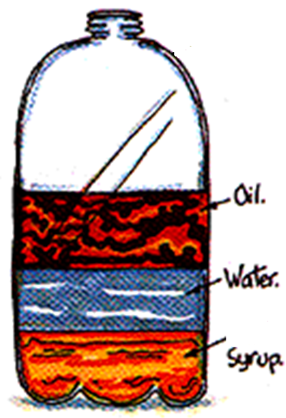
Liquid Layers
Lowest density
Which liquid has the highest density?
Which liquid has the lowest density?
Which liquid has the middle density?
Highest density

Slide 4
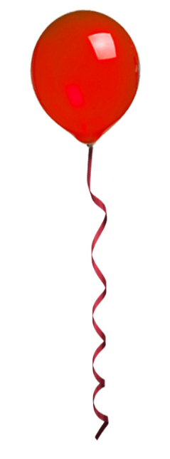
Gasses Also Have Density
Gasses with different densities _______ form layers
  Since gases are __________ it is sometimes hard to see.
  Helium balloons float because helium is _______ dense than air
Wind and weather are the result of ______ density
  Hot air is ____ dense than cold air
  Rising hot air ________ wind and rain

Slide 5
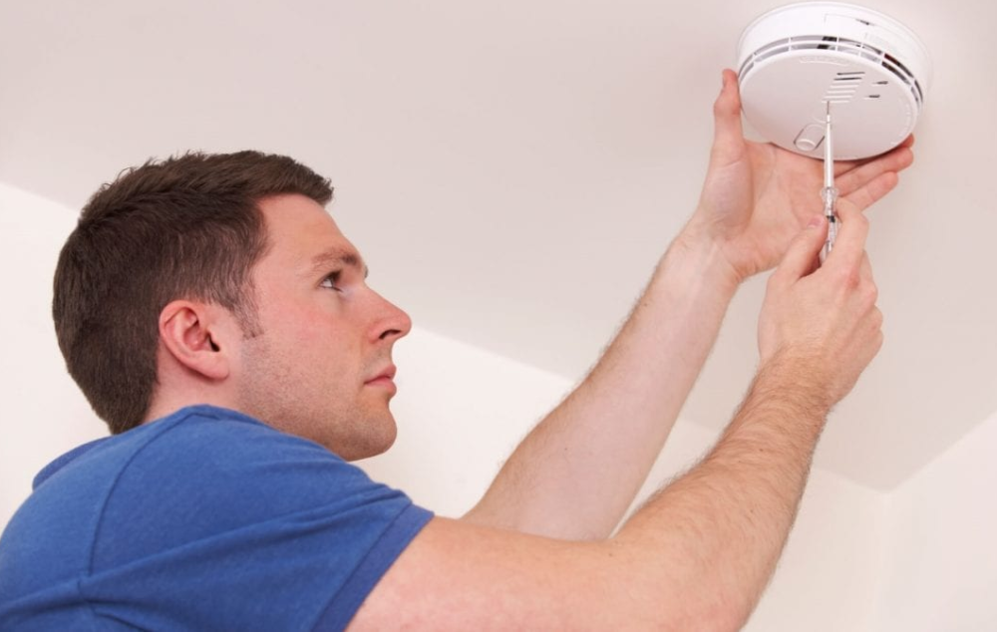
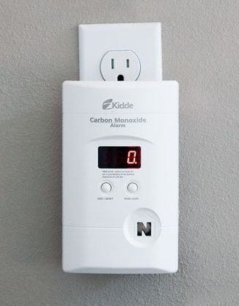
Density & Home Safety
Smoke detectors should be placed on the _________
  _________ particles are less
  dense than air.
Carbon Monoxide detectors should be placed on the ______
  Carbon Monoxide (CO) is the ________ density as air.
  Carbon Monoxide is a _________ gas produced by malfunctioning ____________ and idling cars.

Slide 6
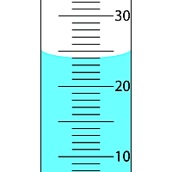
Measuring Volume using a
Graduated Cylinder
The surface of a liquid in a Graduated Cylinder is ____ _____
  Surface tension causes the liquid
  to be ___________ at the sides
This rounded shape is called
a ____________.
We measure the volume at the
___________ of the meniscus
  This volume is: _____ ml

Slide 7
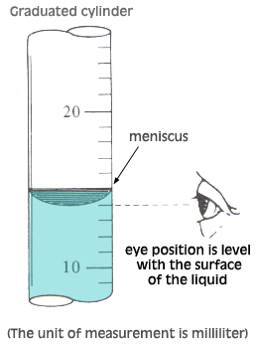
Measuring Volume using a
Graduated Cylinder
You must ________ over to read
the markings on the graduated cylinder.
  The graduated cylinder must be on a __________ ___________
  Your eye must be at the ________
  __________ as the meniscus
You must NEVER _______ ____
the graduated cylinder to bring it up to your eye.

Slide 8
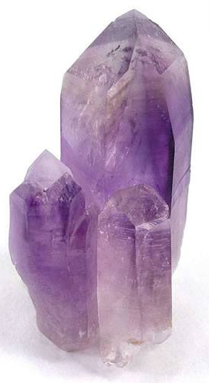
Measuring the Volume of an
Irregular Solid
How can we measure the volume of an irregular _________?
  There are no sides to ______ measure
  There is no ___________ to calculate
  (e.g. L x W x H)
We can use the water ___________ method
  If the solid object sinks then the water level will _____ by the ______ volume as the object.

Slide 9
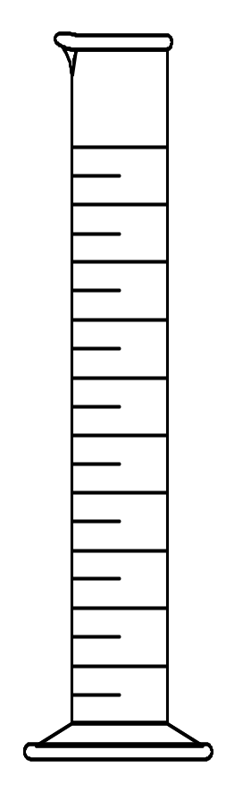
Volume Displacement
A solid displaces a _________ volume of water when placed in water.
33 mL
25 mL

Slide 10
Volume Calculation
Calculate the volume of water displaced by the object
  The volume of water before the object is placed in the graduated cylinder is 25 ml.
  The volume of water before the object is placed in the graduated cylinder is 33 ml.
1) 25 ml 2) 33 ml 3) 8 ml
33 mL
25 mL

Slide 11
Learning Check
What is the density of 48 g of a metal if the metal raises the level of water in a graduated cylinder from 25 mL to 33 mL?
1) 0.2 g/ cm³ 2) 6 g/m³ 3) 252 g/cm³
33 mL
25 mL

